Slide 1
Impact of Covid-19 on NYC Public High School Attendance
Presented by Kenny Mai
and what’s left of his sanity

Slide 2
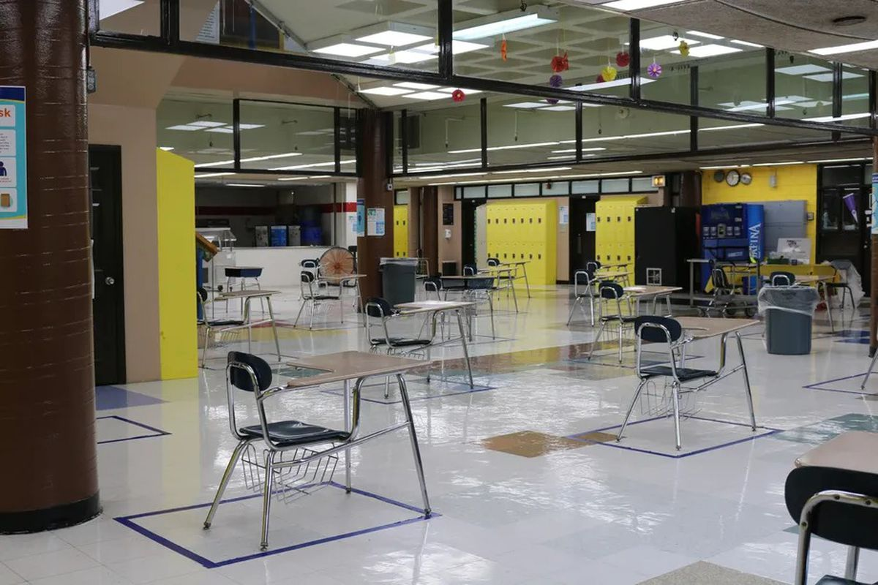
Research Questions
How did the pandemic affect NYC public high school student attendance?
Are some students affected disproportionately compared to others? If so, what do those students have in common?
Is student attendance correlated with adult mobility? Is attendance different for students whose parents were considered essential workers?

Slide 3
Research Questions
How did the pandemic affect NYC public high school student attendance?
Are some students affected disproportionately compared to others? If so, what do those students have in common?
Is student attendance correlated with adult mobility? Is attendance different for students whose parents were considered essential workers?

Slide 4
Research Questions
How did the pandemic affect NYC public high school student attendance?
Are some students affected disproportionately compared to others? If so, what do those students have in common?
Is student attendance correlated with local risk index?

Slide 5



Data Sources

Slide 6
Data Sources
De-identified student-level data
School-level data
No classroom level data
Limited data on parents

Slide 7
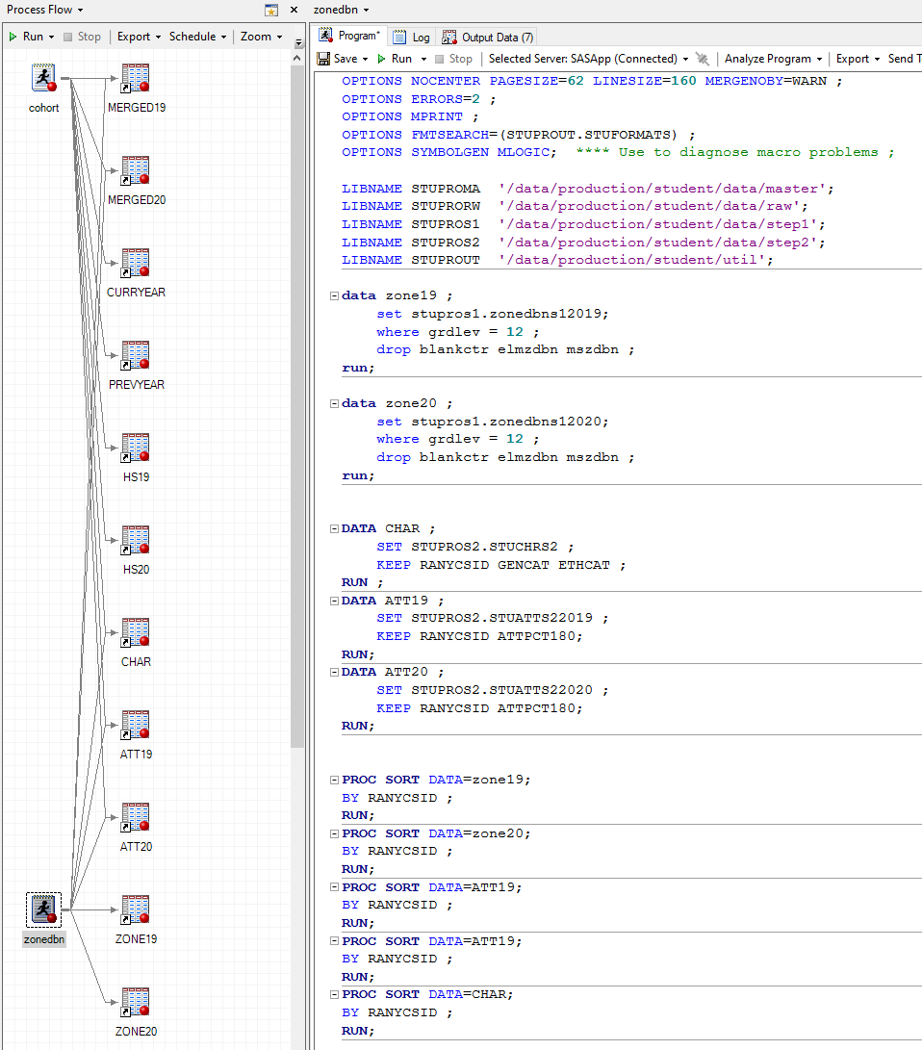
SAS

Slide 8

Data Sources
Centers for Disease Control and Prevention’s Social Vulnerability Index
COVID-19–relevant chronic health conditions, including obesity, coronary heart disease, high blood pressure, chronic kidney disease, and diabetes
COVID-19–relevant demographics, including age and minority status

Slide 9
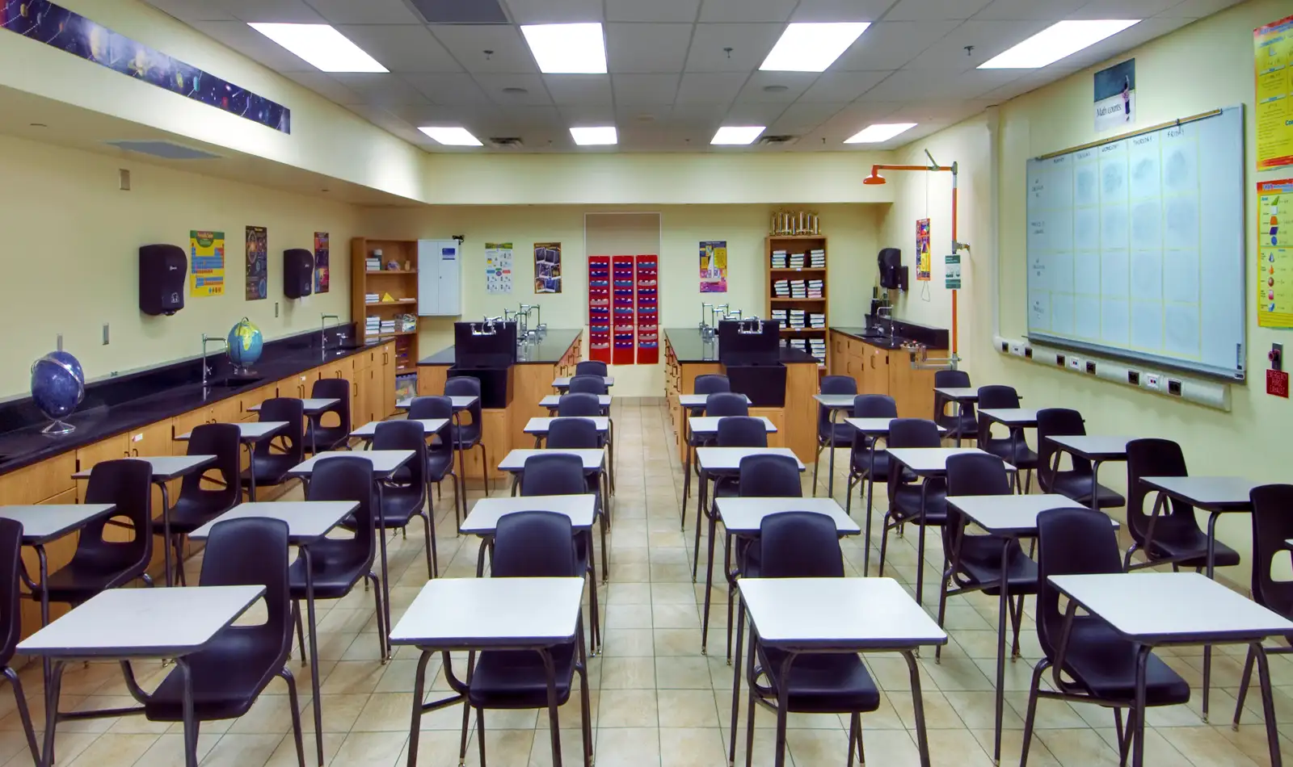
Data
12th graders from 2018-19 and 2019-20, flagged as non-Covid and Covid years, respectively. Comes with demographic information as well as attendance
Reconstruct census codes based on tracts and district locations
Match-merge to Covid Risk Index based on census codes

Slide 10
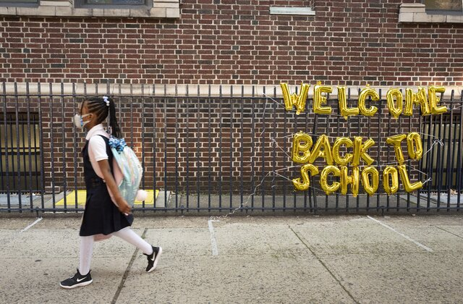
Methods
Don’t break an egg with a hammer
Simple linear regression on the same model on both datasets, ‘19 and ‘20
Attendance ~ Risk + Ethnicity

Slide 11
Results
may surprise you

Slide 12
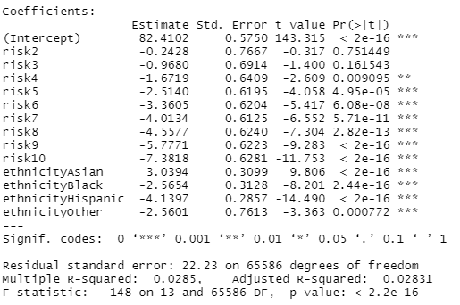
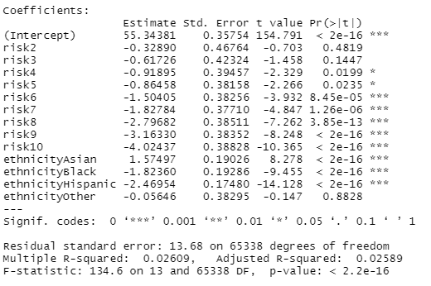
Pre-Covid
Covid

Slide 13
Pre-Covid
Covid

Slide 14
Pre-Covid
Covid

Slide 15
Pre-Covid
Covid

Slide 16
Takeaways
Covid-19 actually closed the gap between students of different ethnicities. While still not equal, the attendance gap between students of different ethnicities did not widen due to Covid.
City Health’s Covid Risk Index is a good indicator of which communities, on the census tract level, will be most affected by a public health crisis.

Slide 17
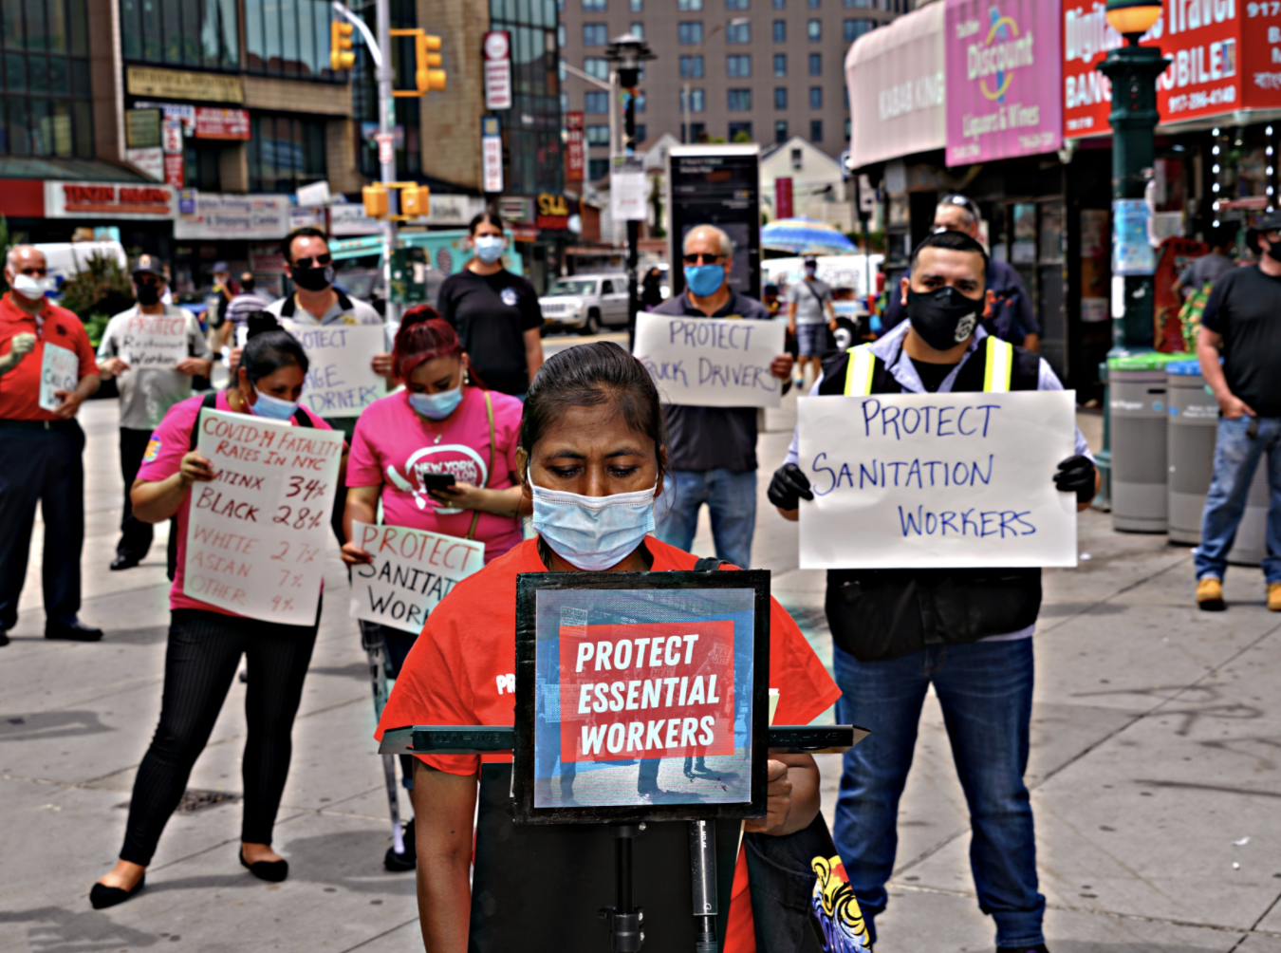
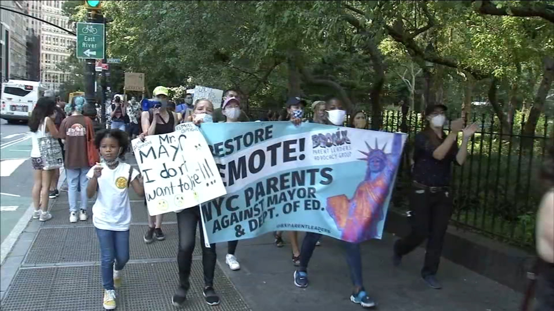
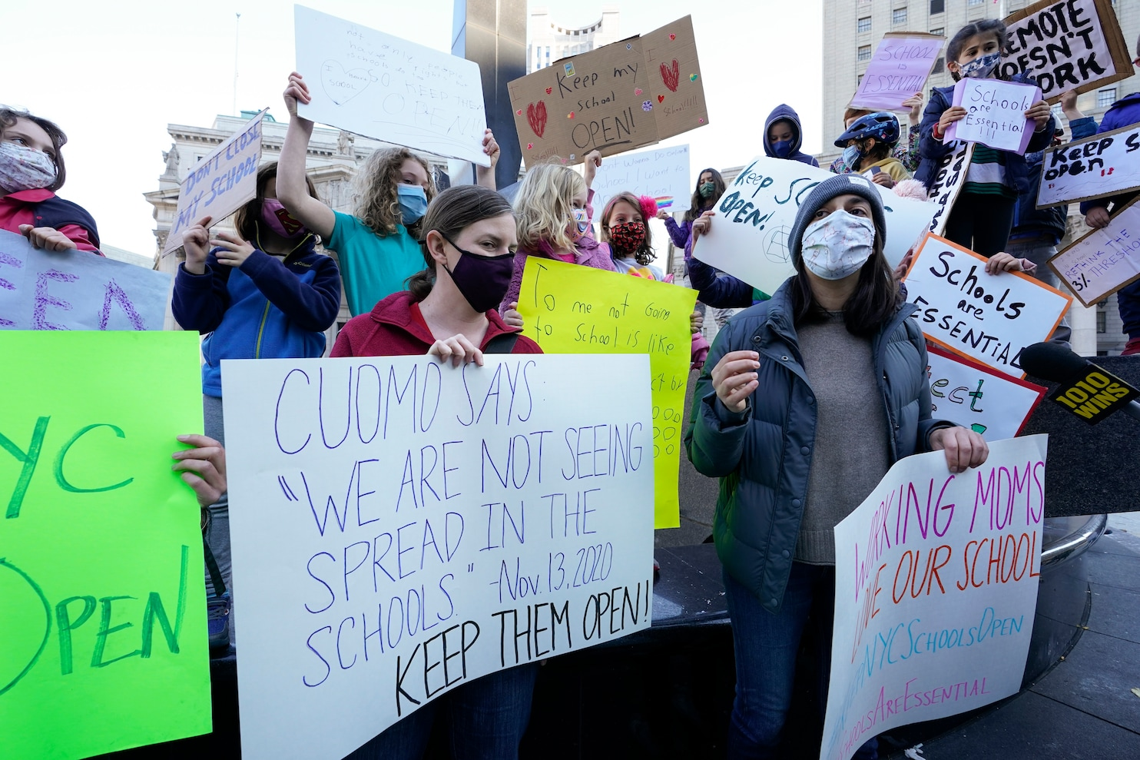
Future Problems
for the world.

Slide 18
That’s it!
Questions?

